Slide 1
London Analysis for Airbnb

Slide 2
Introduction
To find the best neighborhood for Airbnb in London, UK
Consider the following:
- Price per night
- Number of attractions

Slide 3
Data sources
Wikipedia: for London neighborhood information
Foursquare: for venue information of London
Insideairbnb.com: for detailed information about Airbnb listings in London

Slide 4
Methodology
Obtain the 33 neighborhood of London from Wikipedia, including name, longitude and latitude.
Use the longitude and latitude to get venue information within 1km of each neighborhood
Obtain detailed listing information of Airbnb in London, calculated the average price per bed per night for each neighborhood
Merged the above data to get a consolidated dataset.
Sorted the neighborhood by average price and number of venues.

Slide 5
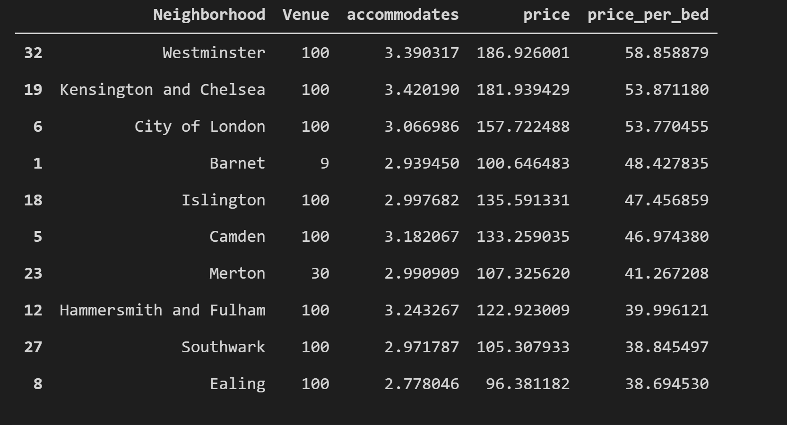
Result

Slide 6
Conclusion
Three best neighborhood for Airbnb
- Westminster
- Kensington and Chelsea
- City of London

